Slide 1
Smart Battery Charger
For you and for the world
Team members:
Anna Geraci
Carlo Simone
Fabio Gianino
Michele Petrocelli

Slide 2
General information about Smart Battery Charger application
Objective:
Main characteristics:
Stakeholders:
IMMAGINE

Slide 3
Communication paradigms used
REST:
How it works
MQTT How it works

Slide 4
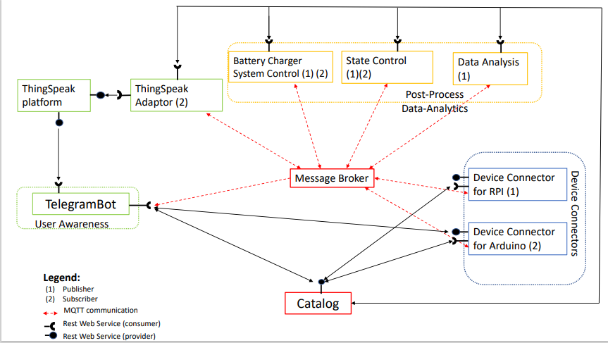
Use Case Diagram - proposal

Slide 5
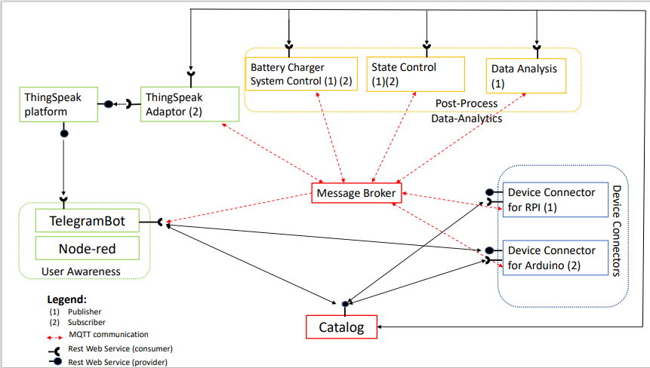
Use Case Diagram - update

Slide 6
Catalog

Slide 7
Device Connectors

Slide 8
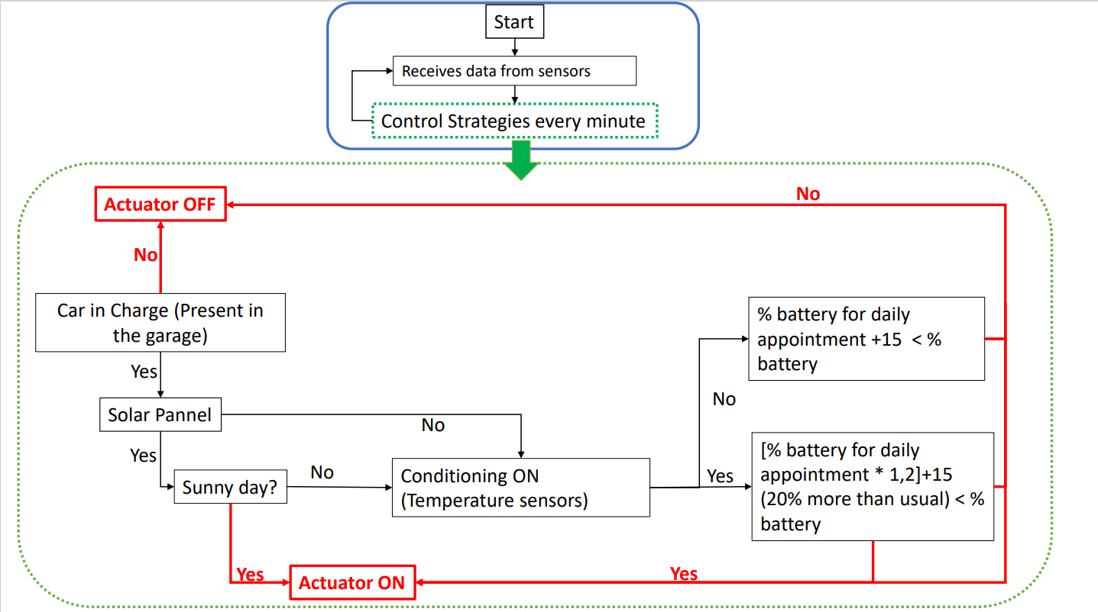
Battery Charger System Control

Slide 9
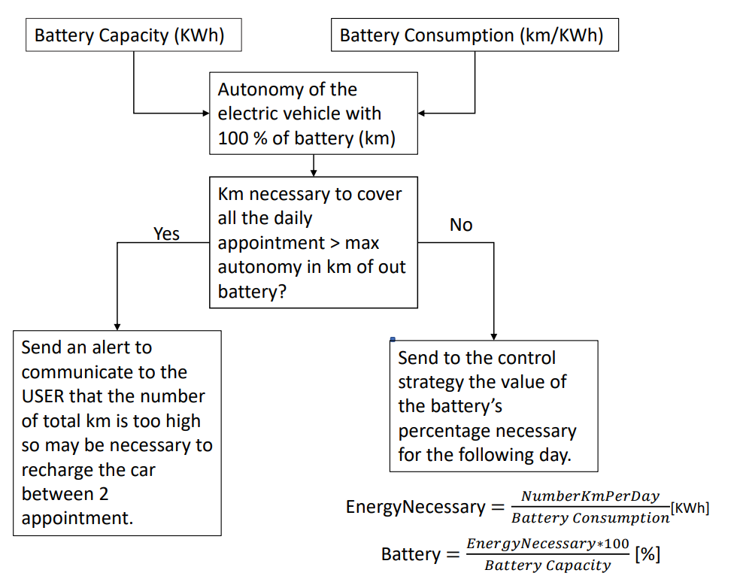
Control Strategy Agenda

Slide 10
State Control

Slide 11
Data Analisys & ThingSpeak

Slide 12
Node-red

Slide 13
Telegram Bot

